Slide 1
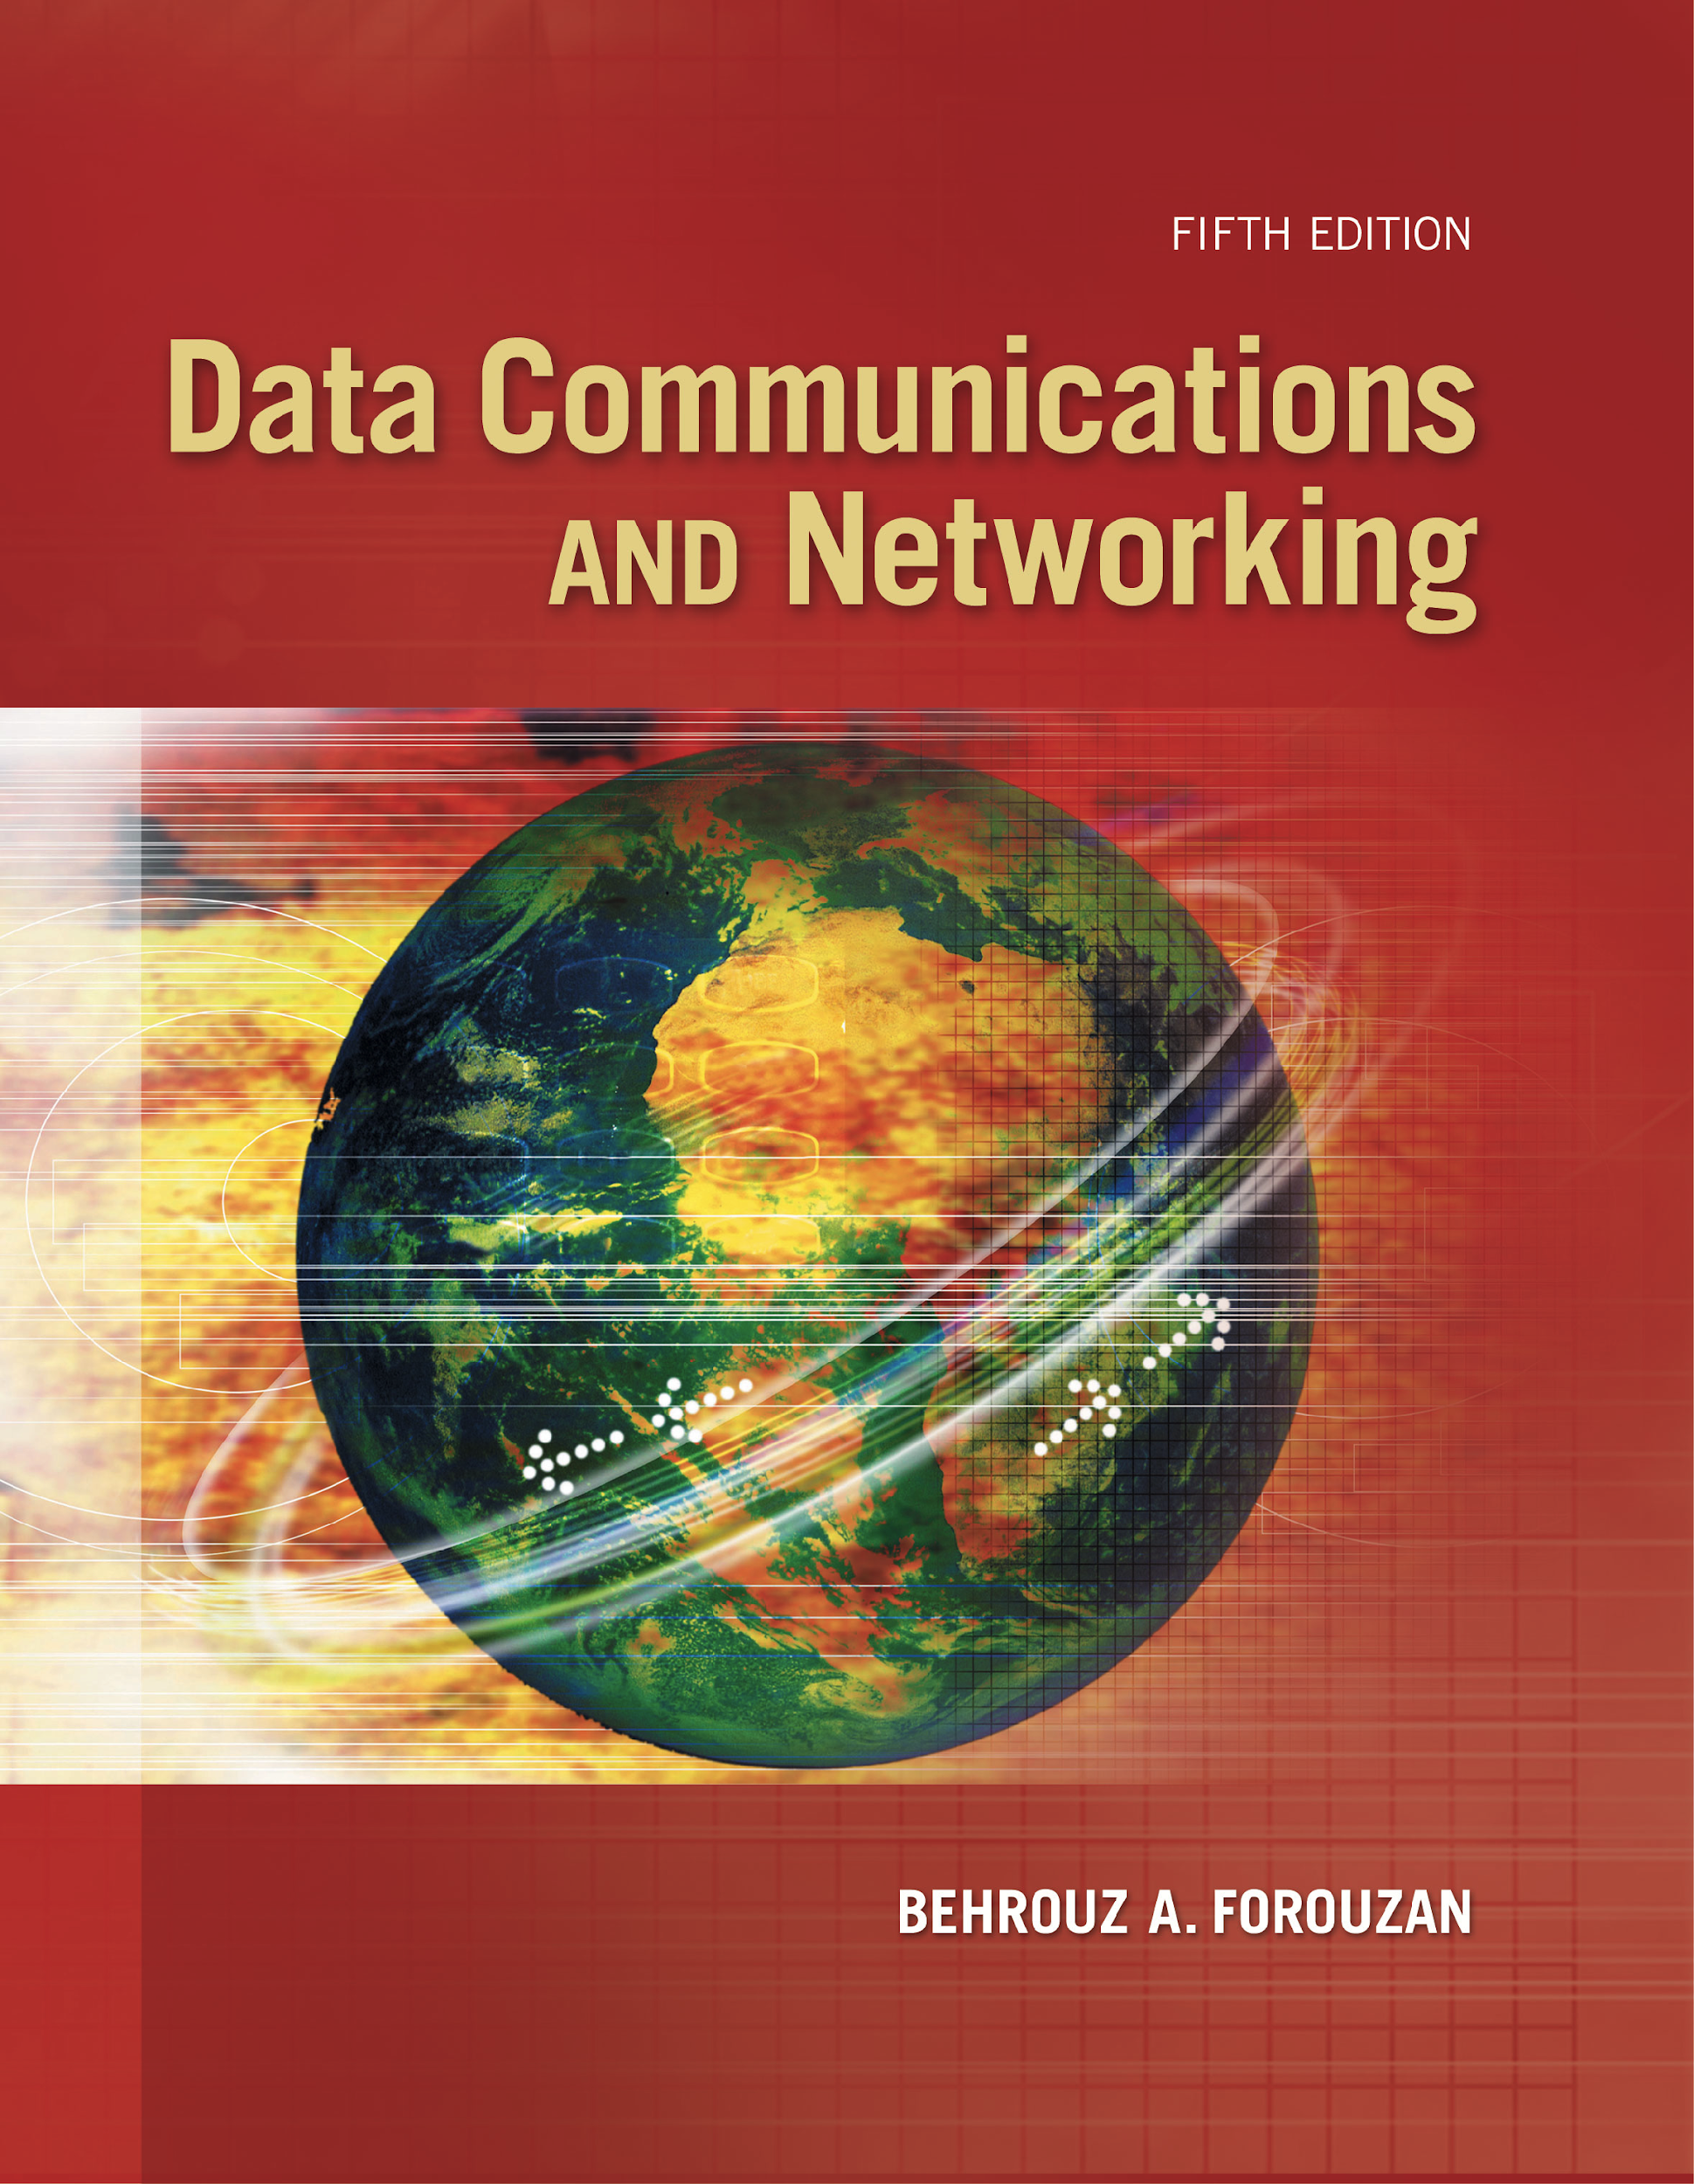
Chapter 17
Connecting
Devices
And
Virtual
LANs
Copyright © The McGraw-Hill Companies, Inc. Permission required for reproduction or display.
Notes:
1

Slide 2
Chapter 17: Outline
17.1 CONNECTING DEVICES
17.2 VIRTUAL LANS
Notes:
17.#

Slide 3

Chapter 17: Objective
The first section discusses connecting devices. It first describes hubs and their features. The section then discusses link-layer switches (or simply switches, as they are called), and shows how they can create loops if they connect LANs with broadcast domains.
The second section discusses virtual LANs or VLANs. The section first shows how membership in a VLAN can be defined. The section then discusses the VLAN configuration. It next shows how switches can communicate in a VLAN. Finally, the section mentions the advantages of a VLAN..
Notes:
17.#

Slide 4
17-1 CONNECTING DEVICES
Hosts and networks do not normally operate in isolation. We use connecting devices to connect hosts together to make a network or to connect networks together to make an internet. Connecting devices can operate in different layers of the Internet model. We discuss three kinds of connecting devices: hubs, link-layer switches, and routers.
Hub is replacement of repeater
17.4
Notes:
17.#

Slide 5
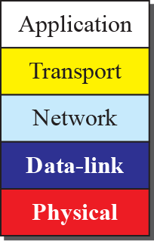
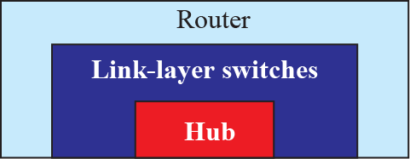
Figure 17.1: Three categories of connecting devices
17.5
Notes:
17.#

Slide 6
17.17.1 Hubs
A hub is a device that operates only in the physical layer. Signals that carry information within a network can travel a fixed distance before attenuation endangers the integrity of the data. A repeater receives a signal and, before it becomes too weak or corrupted, regenerates and retimes the original bit pattern.
17.6
Notes:
17.#

Slide 7
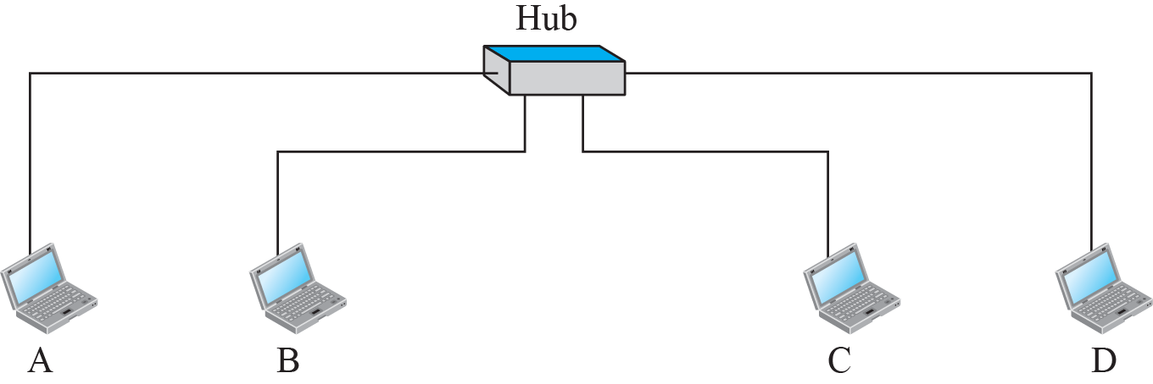
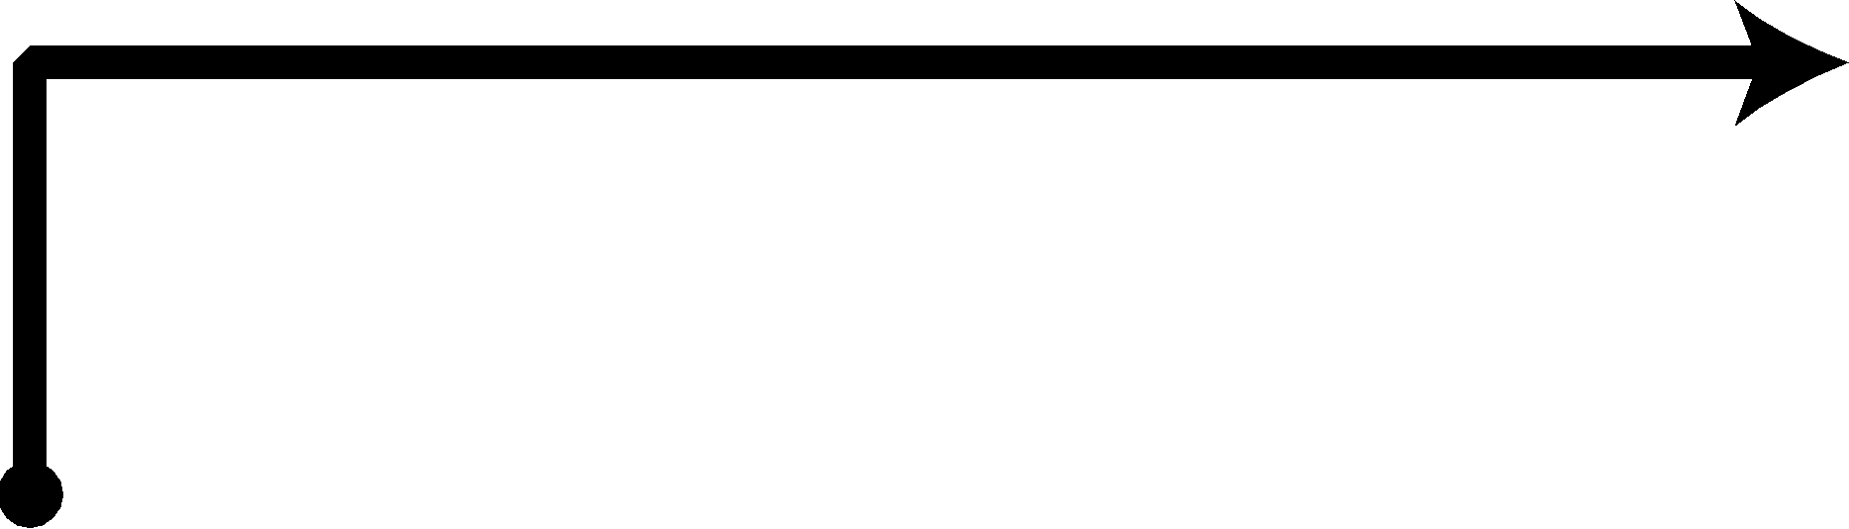
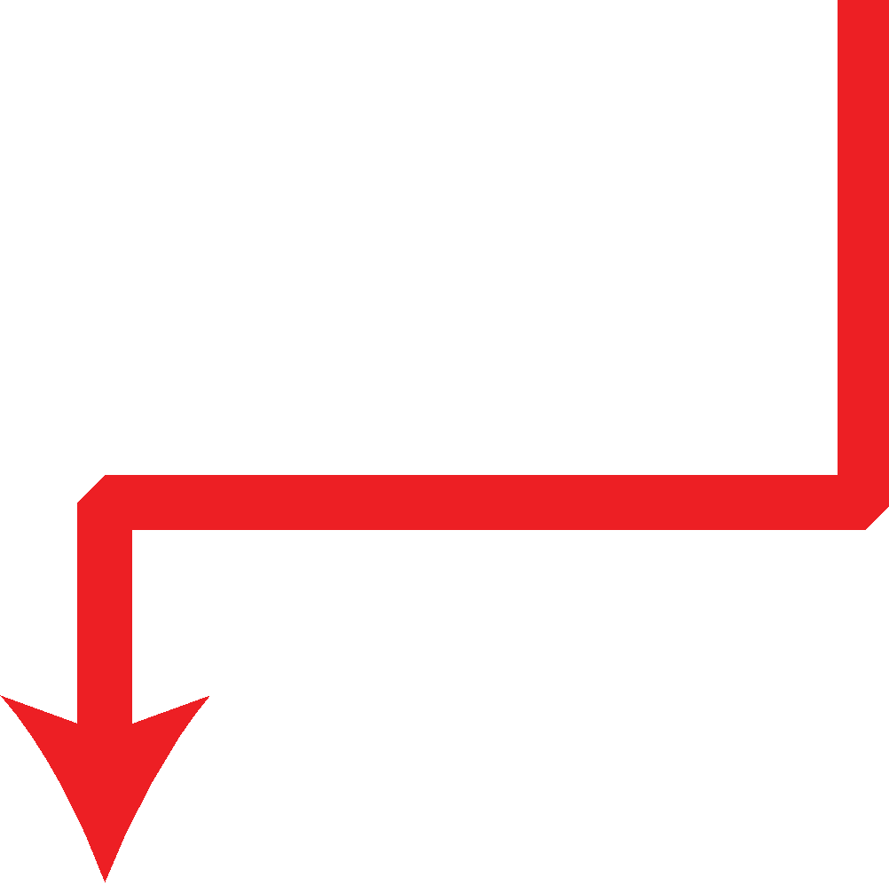
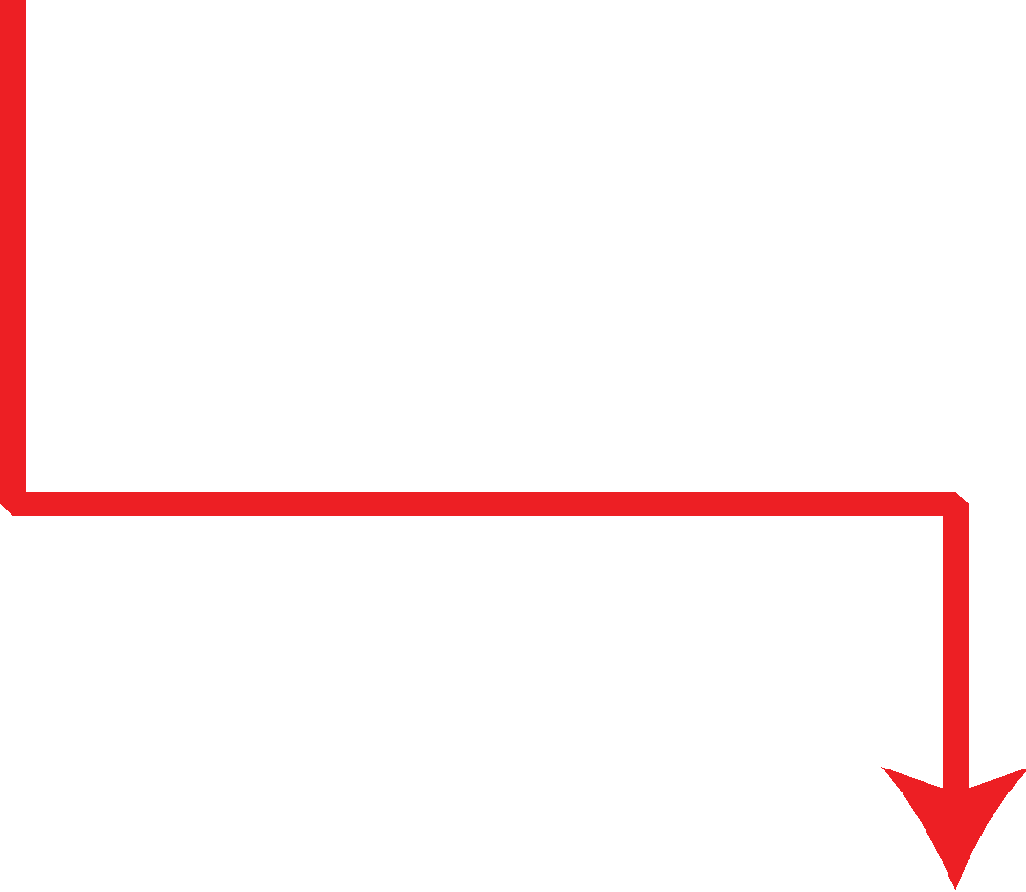




Figure 17.2: Hub
17.7
Notes:
17.#

Slide 8
17.17.2 Link-Layer Switches
A link-layer switch (or switch) operates in both the physical and the data-link layers. As a physical-layer device, it regenerates the signal it receives. As a link-layer device, the link-layer switch can check the MAC addresses (source and destination) contained
in the frame.
17.8
Notes:
17.#

Slide 9
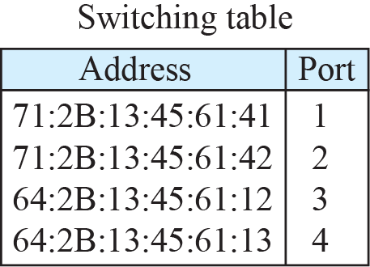
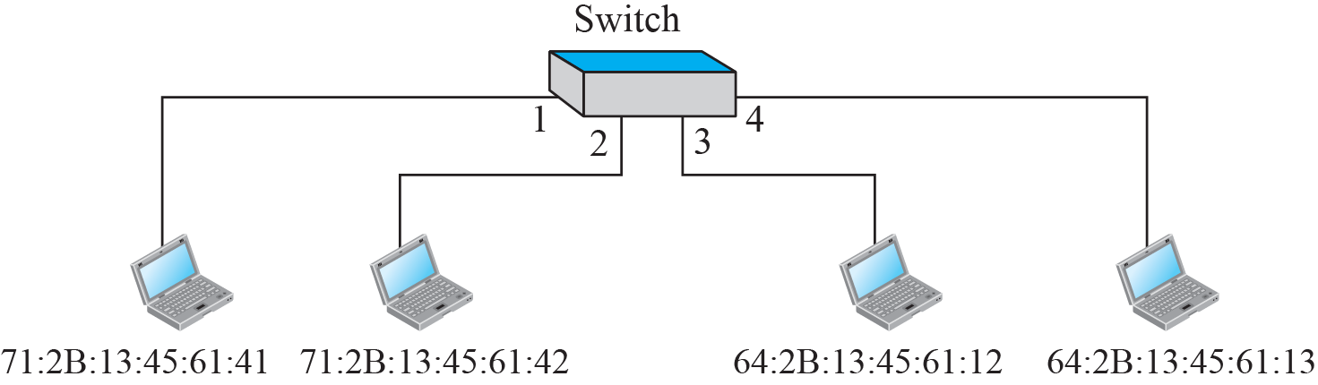
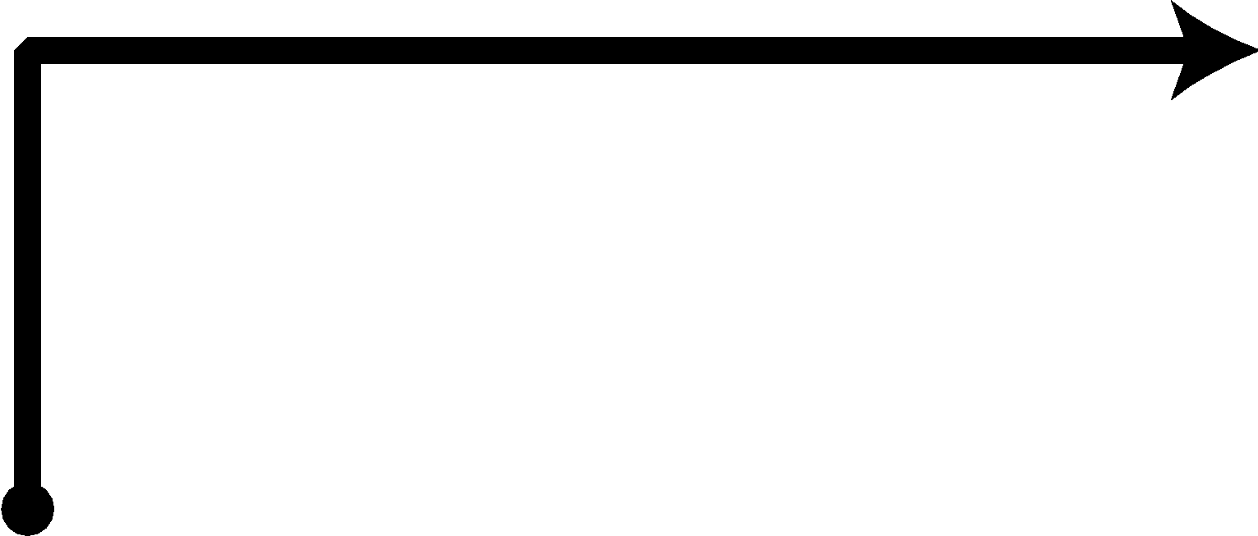

Figure 17.3: Link-Layer Switch
17.9
Notes:
17.#

Slide 10

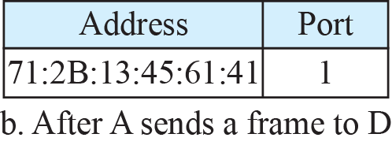
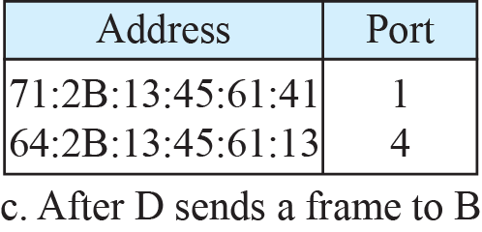
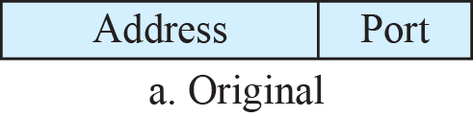
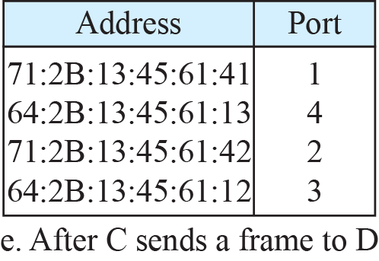
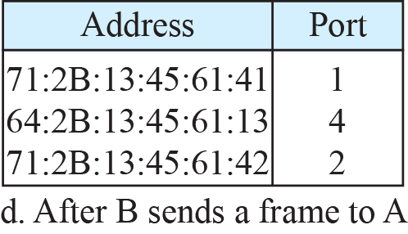

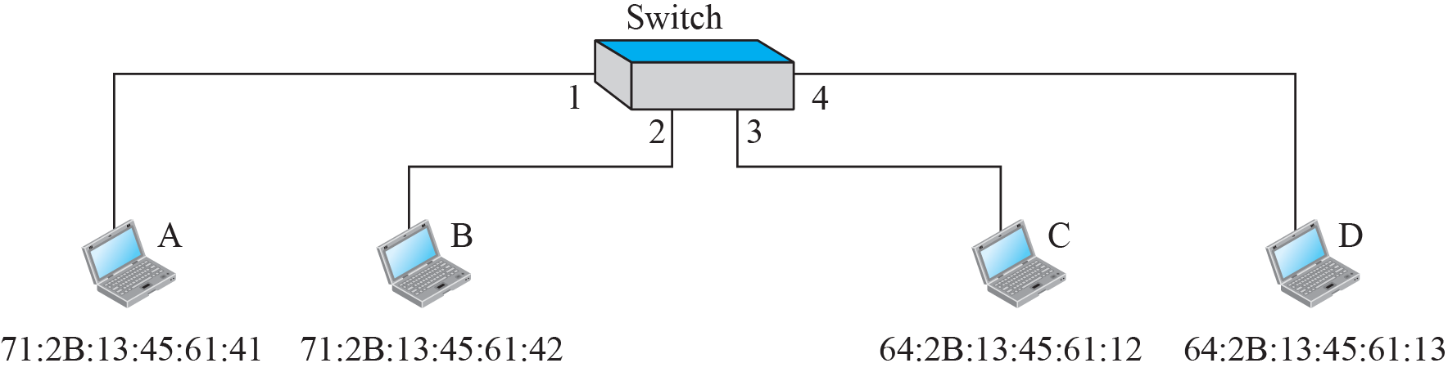
Figure 17.4: Learning switch
17.10
Notes:
17.#

Slide 11
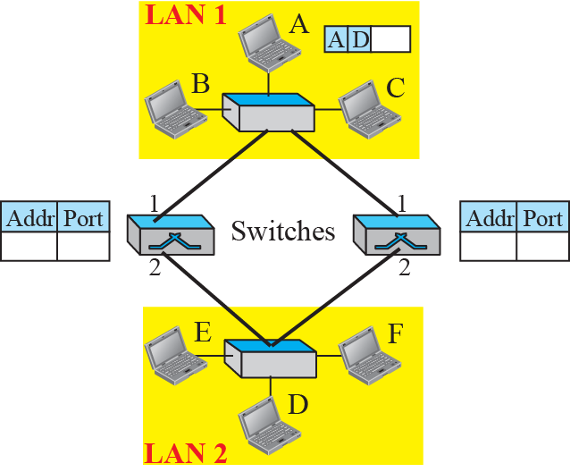
Figure 17.5: Loop problem in a learning switch (Part a)
17.11
Notes:
17.#

Slide 12
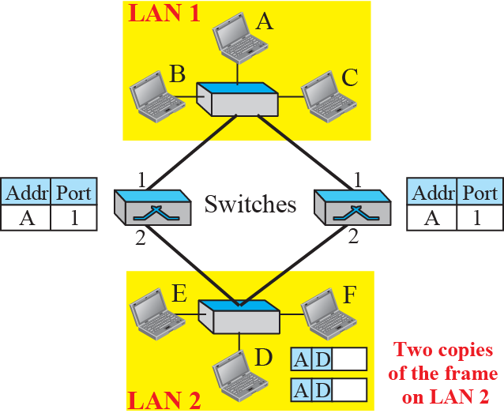
Figure 17.5: Loop problem in a learning switch (Part b)
17.12
Notes:
17.#

Slide 13
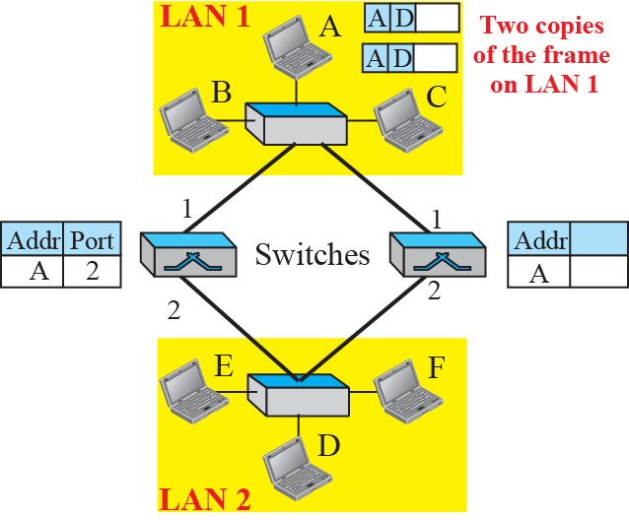
Figure 17.5: Loop problem in a learning switch (Part c)
17.13
Notes:
17.#

Slide 14
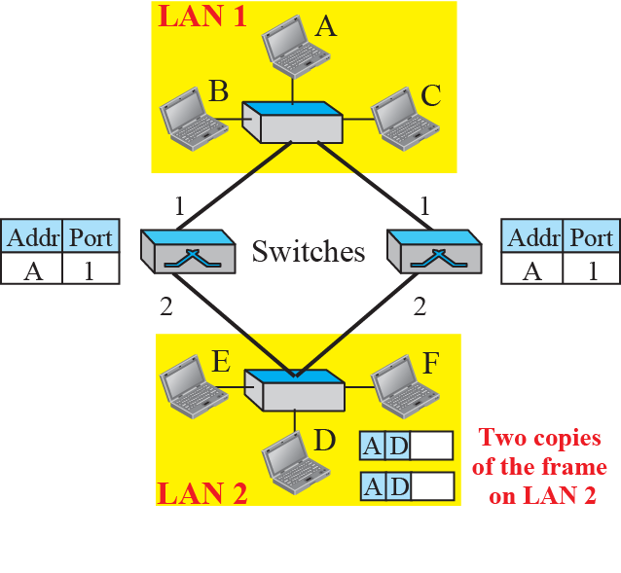
Figure 17.5: Loop problem in a learning switch (part d)
17.14
Notes:
17.#

Slide 15
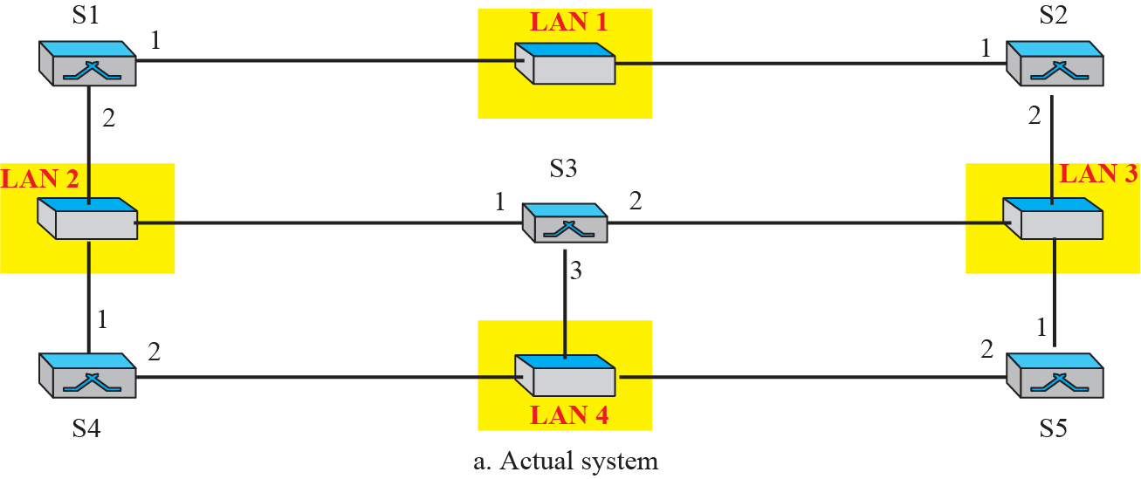
Figure 17.6: A system of connected LANs and its graph (Part a)
17.15
Notes:
17.#

Slide 16
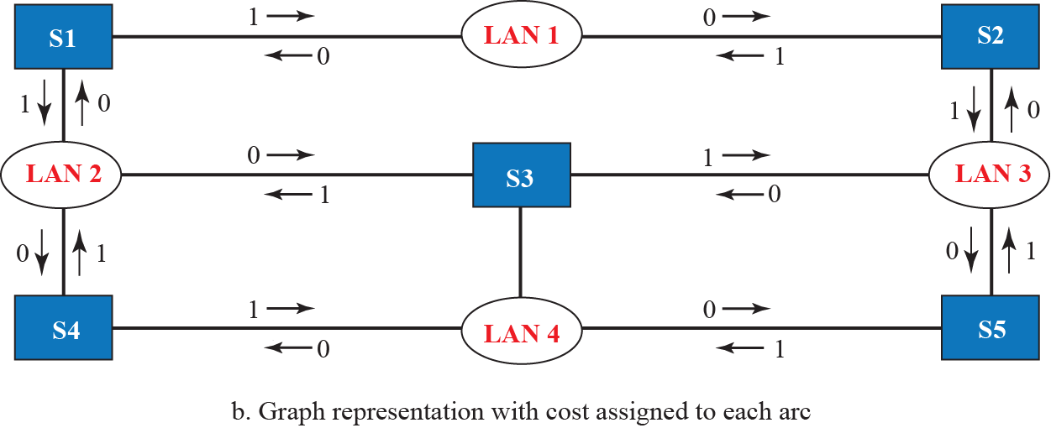
Figure 17.6: A system of connected LANs and its graph (Part b)
1=goes to LAN side
0=goes to switch side
17.16
Notes:
17.#

Slide 17
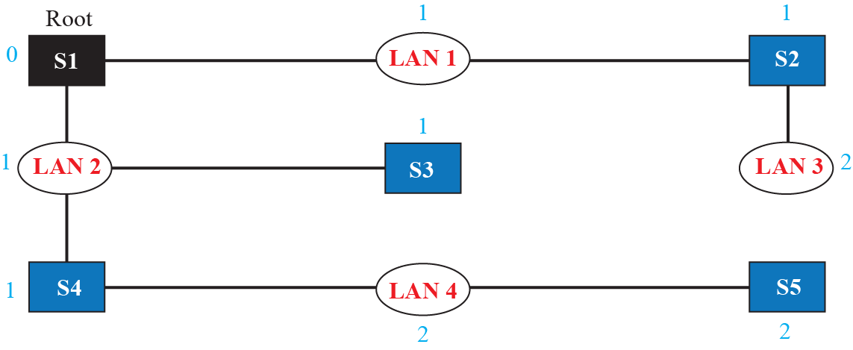
Figure 17.7: Finding the shortest path and the spanning tree for a switch.
17.17
Notes:
17.#

Slide 18
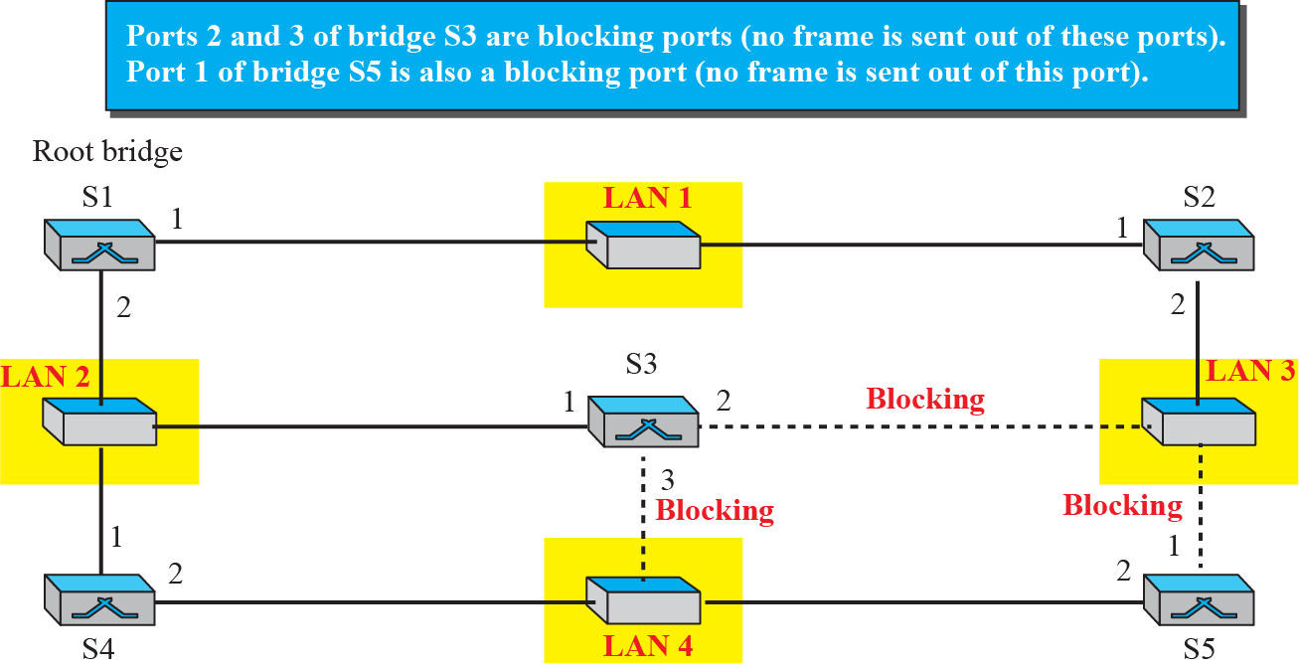
Figure 17.8: Forwarding and blocking ports after using spanning tree algorithm
17.18
Notes:
17.#

Slide 19
17.17.3 Routers
We will discuss routers in Part IV of the book when we discuss the network layer. In this section, we mention routers to compare them with a two-layer switch and a hub. A router is a three-layer device; it operates in the physical, data-link, and network layers.
17.19
Notes:
17.#

Slide 20
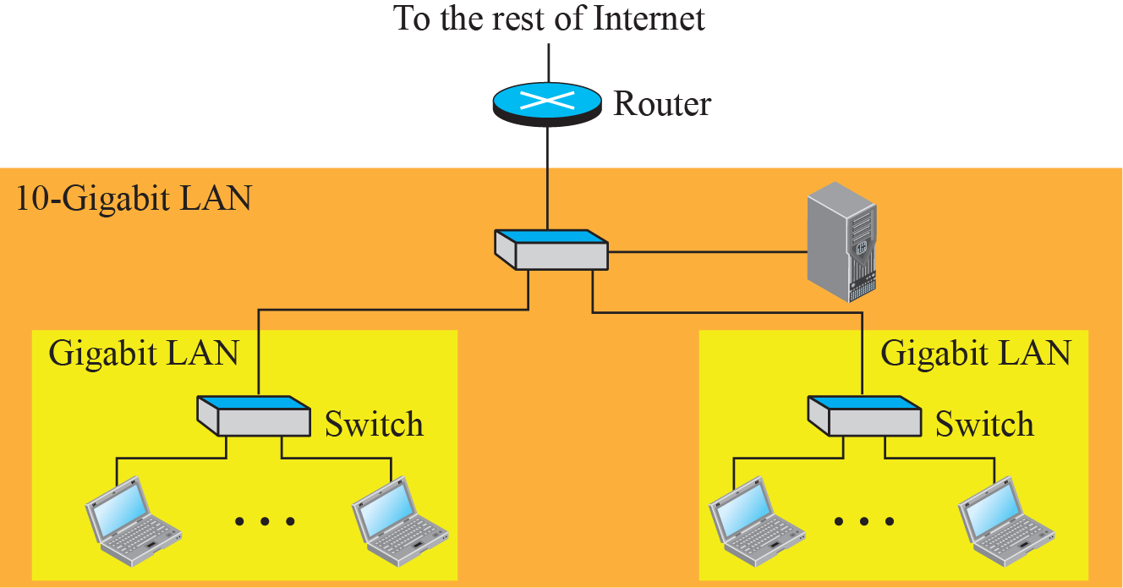
Figure 17.9: Routing example
17.20
Notes:
17.#

Slide 21
17-2 VIRTUAL LANS
A station is considered part of a LAN if it physically belongs to that LAN. The criterion of membership is geographic. What happens if we need a virtual connection between two stations belonging to two different physical LANs? We can roughly define a virtual local area network (VLAN) as a local area network configured by software, not by physical wiring.
17.21
Notes:
17.#

Slide 22
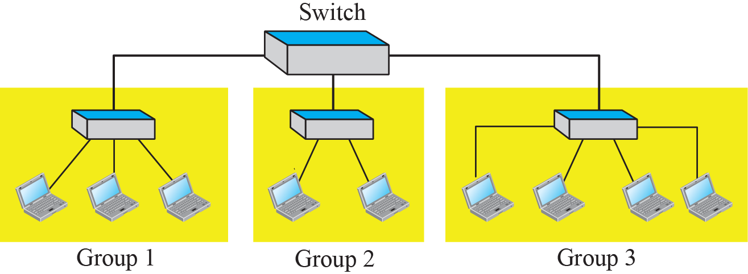
Figure 17.10: A switch connecting three LANs
17.22
Notes:
17.#

Slide 23
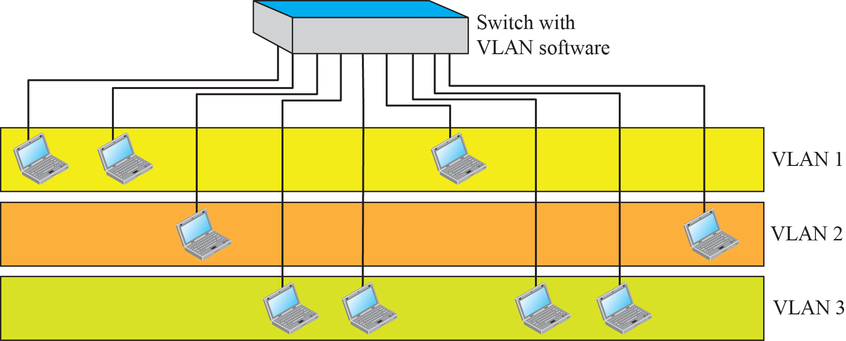
Figure 17.11: A switch using VLAN software
17.23
Notes:
17.#

Slide 24
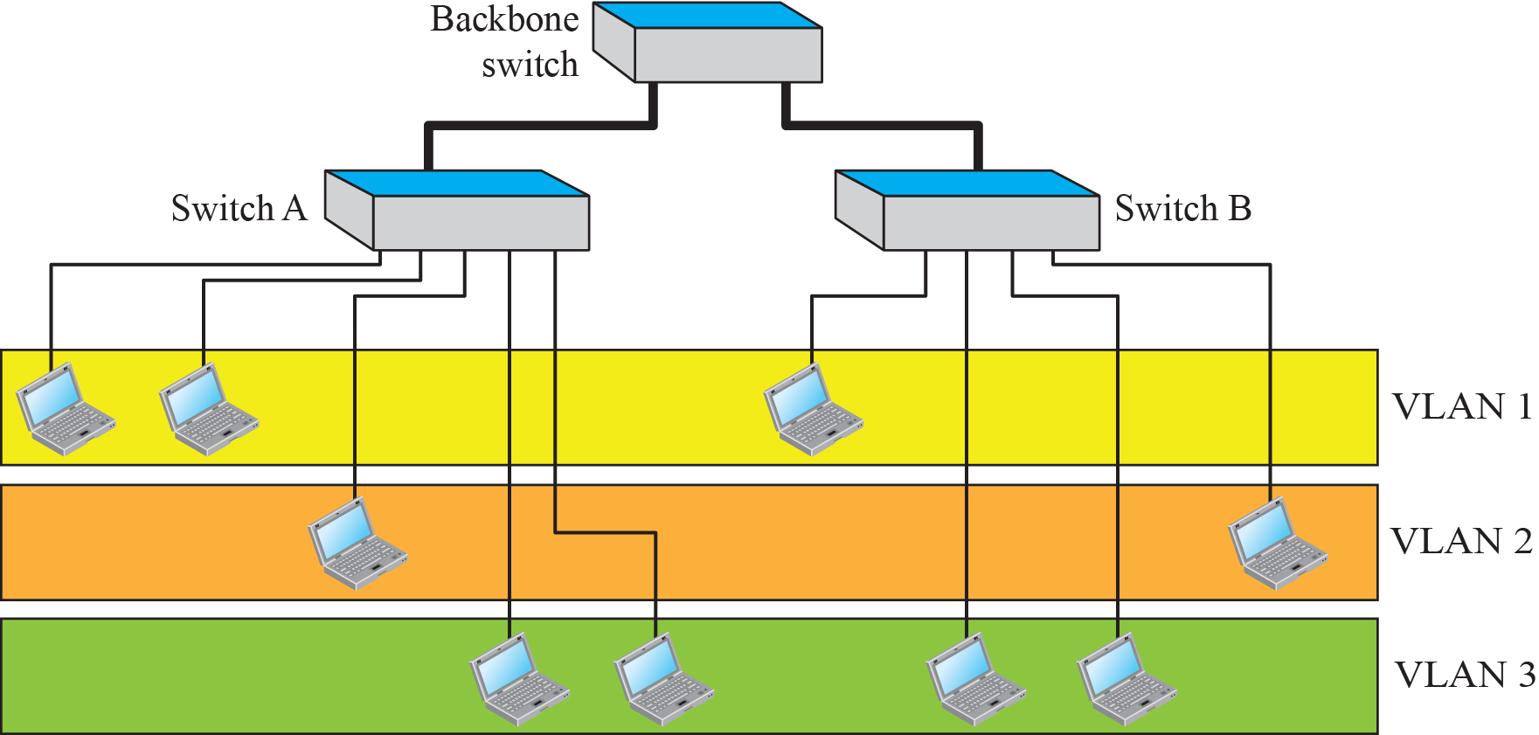
Figure 17.12: Two switches in a backbone using VLAN software
17.24
Notes:
17.#

Slide 25
17.2.1 Membership
What characteristic can be used to group stations in a VLAN? Vendors use different characteristics such as interface numbers, port numbers, MAC addresses, IP addresses, IP multicast addresses, or a combination of two or more of these.
17.25
Notes:
17.#

Slide 26
17.2.2 Configuration
How are the stations grouped into different VLANs? Stations are configured in one of three ways: manually, semi-automatically, and automatically.
17.26
Notes:
17.#

Slide 27
17.2.3 Communication between Switches
In a multi-switched backbone, each switch must know not only which station belongs to which VLAN, but also the membership of stations connected to other switches. For example, in Figure 17.12, switch A must know the membership status of stations connected to switch B, and switch B must know the same about switch A. Three methods have been devised for this purpose: table maintenance, frame tagging, and time-division multiplexing.
17.27
Notes:
17.#

Slide 28
17.2.4 Fourth Generation (4G)
The fourth generation of cellular telephony is expected to be a complete evolution in wireless communications. Some of the objectives defined by the 4G working group are discussed in this section.
17.28
Notes:
17.#

